Slide 1

AGB1211 – DESIGN THINKING
Department of Artificial Intelligence and Data Science
Academic Year: 2024 – 2025 (Odd Semester)
Year : II
Semester : III
Section : A
Date : 05.12.2024
PRESENTED BY
1. AKSHAYAMATHI D
2. ARUNA J
3. DEVA DHARSHINI J
4.DEVA DHARSHINI K
AGB1211 – DESIGN THINKING

Slide 2
Title of the Project
LEARN OR PLAY FOR
CHILDREN WITH
DISABILITY
AGB1211 – DESIGN THINKING

Slide 3
Problem Identification
Developmental and Sensory Challenges
  Delays in development, sensory impairments, and physical limitations hinder engagement with educational materials and recreational activities.
Social and Emotional Barriers
  Communication difficulties and behavioral issues lead to challenges in social interaction, often resulting in feelings of isolation.
Environmental Limitations
  Inaccessible playgrounds and lack of adaptive equipment restrict opportunities for inclusive play.
Learning Barriers
  Struggles with conventional teaching methods require specialized strategies and assistive technologies to support learning.
AGB1211 – DESIGN THINKING

Slide 4
Objective
Objective of Learn and Play Opportunities for Children with Disabilities:
Foster an inclusive environment supporting overall development and well-being.
Ensure accessible and tailored educational resources with adaptive teaching methods and assistive technologies.
Create inclusive play spaces with adaptive equipment to encourage social interaction, physical activity, and emotional growth.
Promote holistic development, empowering children to lead fulfilling and inclusive lives.
AGB1211 – DESIGN THINKING

Slide 5
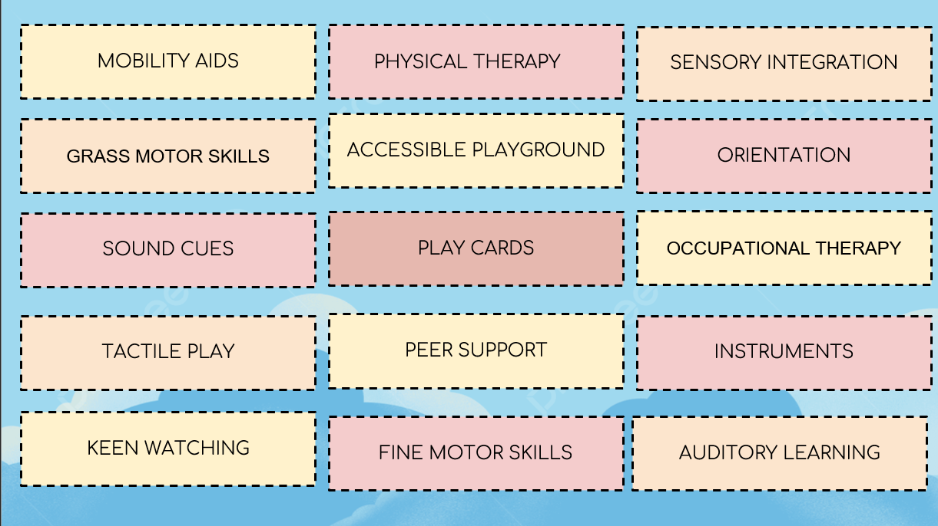
Brain Storming
AGB1211 – DESIGN THINKING

Slide 6
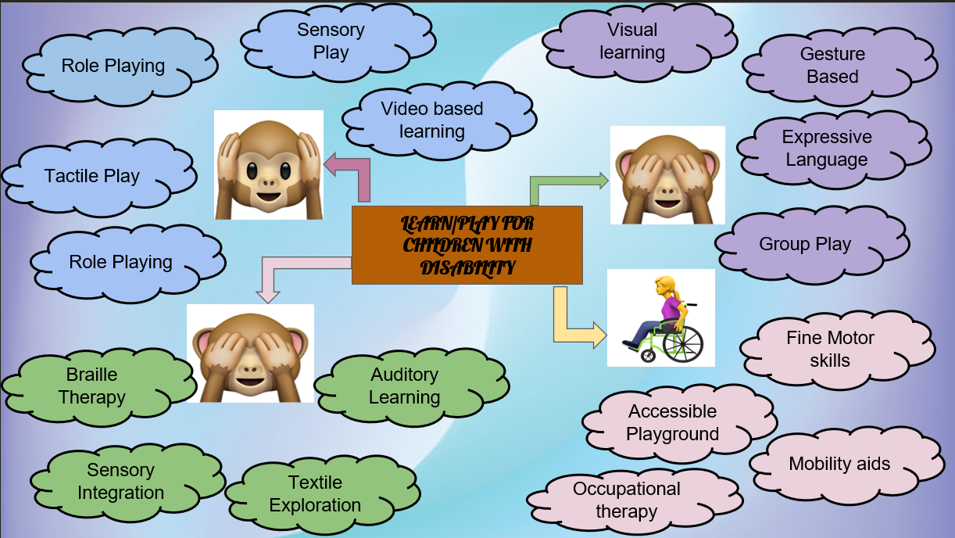
Mind Map
AGB1211 – DESIGN THINKING

Slide 7
Primary Research
Directly collecting data from stakeholders to understand their needs and experiences.
A. Methods
Interviews
Target: Parents, caregivers, educators, therapists, and the children (when appropriate).
Purpose:
1.Understand daily challenges.
2.Identify gaps in existing tools or systems.
Sample Questions:
3."What are the biggest challenges your child faces during play/learning?"
4."What adaptations or tools have been most effective?"
Focus Groups
Target: Groups of parents, teachers, or caregivers.
Purpose: Gain collective insights on common needs and shared challenges.
B. Tools
Video/audio recordings (with consent).
Behavior tracking sheets.
Accessibility checklists for environments and tools.
AGB1211 – DESIGN THINKING

Slide 8
Secondary Research
Using existing data and literature to inform the problem space and potential solutions.
A. Sources
Academic Journals
Topics:
Inclusive education.
Adaptive technologies for disabilities.
Social-emotional development in children with disabilities.
Government Reports
Examples:
Guidelines on special education and inclusive play.
Data on the prevalence of disabilities among children
Combining Insights
Analyze Gaps: Compare findings from primary research (direct needs) and secondary research (existing solutions
Validate Ideas: Use secondary research to support or challenge primary data.
Identify Trends: Look for recurring themes across both sources.
Develop Personas: Based on research, create user profiles to guide solution design.
Iterate Solutions: Use insights to adapt or refine ideas for learning/play materials.
Prototype Testing: Validate ideas through pilot studies, combining qualitative (e.g., feedback) and quantitative (e.g., engagement rates) data.
AGB1211 – DESIGN THINKING

Slide 9
Proposed Work
Key Steps in Developing a Learning and Play App for Children with Disabilities:
Define Purpose and Tailor Features
  Identify the app's target audience and conduct individual assessments to address specific needs.
Inclusive Play and Learning Activities
  Incorporate sensory, physical, cognitive, social, and creative play options to support diverse developmental areas.
Accessibility and User-Friendly Design
  Use assistive technologies (voice commands, adaptive touch) and provide customizable, intuitive interfaces.
Parental Involvement and Continuous Improvement
  Include tutorials, progress tracking, and feedback mechanisms to engage caregivers and enhance the app over time.
AGB1211 – DESIGN THINKING

Slide 10
List of Modules
1)Dashboard Module
2)Sensory Play Module
3)Communication Module
4)Cognitive Development Module
5)Accessibility and Assistive Technology Module
AGB1211 – DESIGN THINKING

Slide 11
Module 1 Description
Dashboard Module
Purpose: Central hub for navigation, progress tracking, and personalization.
Features:
  User profiles for children, caregivers, and educators.
  Progress tracking: Displays milestones, achievements, and areas for improvement.
  Accessible interface with customizable themes, fonts, and colors to cater to different visual or cognitive needs.
AGB1211 – DESIGN THINKING

Slide 12
Module 2 Description
Sensory Play Module
Purpose: Enhance sensory skills through interactive activities.
Features:
    Visual stimulation: Games with vibrant colors, patterns, and animations.
    Auditory activities: Sounds, music, and voice interactions for auditory development.
    Tactile engagement (with external devices): Activities prompting physical responses like tapping or swiping.
AGB1211 – DESIGN THINKING

Slide 13
Module 3 Description
Communication Module
Purpose: Support children with communication challenges, including non-verbal learners.
Features:
    Picture Exchange Communication System (PECS): Virtual cards for expressing needs or emotions.
    Speech-to-text and text-to-speech options.
    Visual storytelling: Build stories with pictures and captions.
AGB1211 – DESIGN THINKING

Slide 14
Module 4 Description
Cognitive Development Module
Purpose: Develop problem-solving, memory, and critical thinking skills.
Features:
    Puzzles: Jigsaws, matching games, or sequencing tasks.
    Memory games: Matching cards or objects.
    Cause-and-effect activities: Interactive buttons triggering animations or sounds.
AGB1211 – DESIGN THINKING

Slide 15
Module 5 Description
Accessibility and Assistive Technology Module
Purpose: Ensure the app is usable by children with diverse abilities.
Features:
    Integration with assistive devices (e.g., eye-gaze trackers, switches).
    Alternative inputs: Voice commands, gesture recognition, or touch-free controls.
    Multiple language and auditory support options.
AGB1211 – DESIGN THINKING

Slide 16
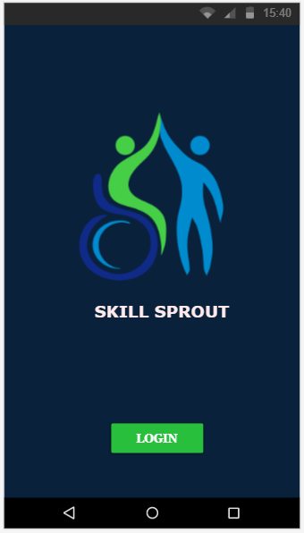
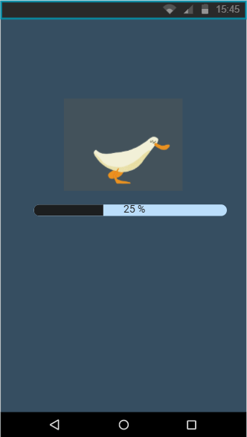
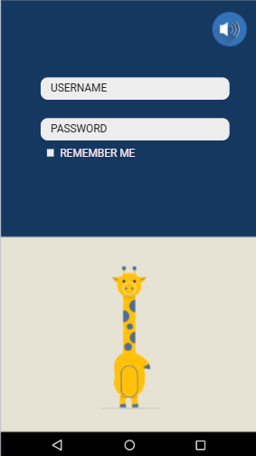
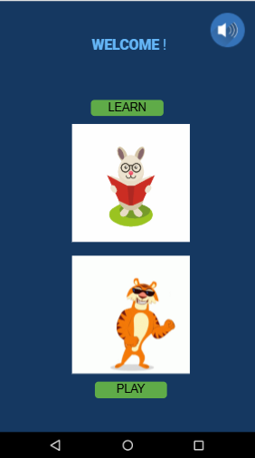
Results
AGB1211 – DESIGN THINKING

Slide 17
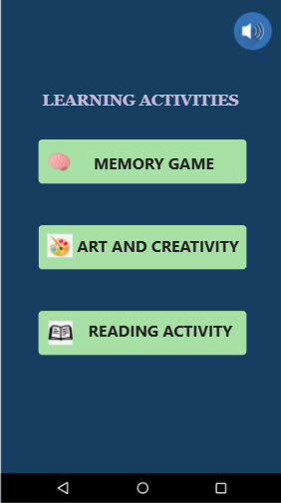
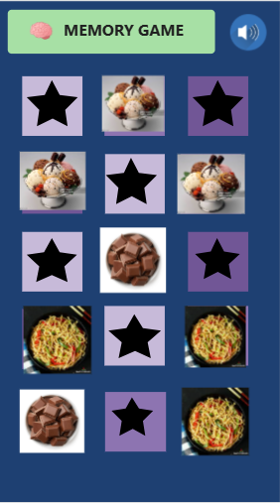
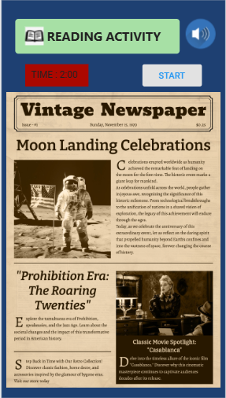
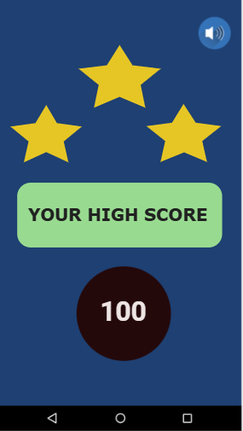
Results
AGB1211 – DESIGN THINKING

Slide 18
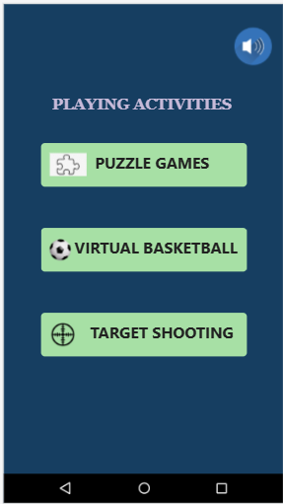
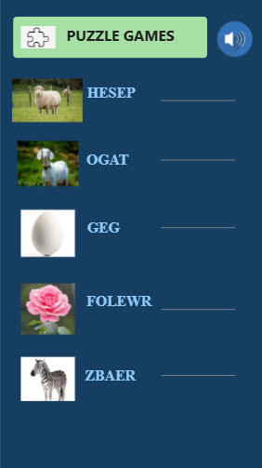
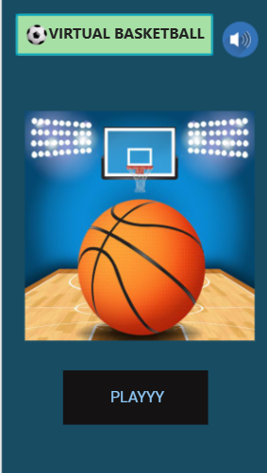
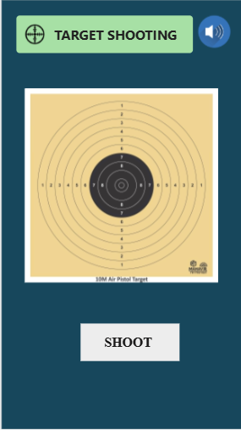
Results
AGB1211 – DESIGN THINKING

Slide 19
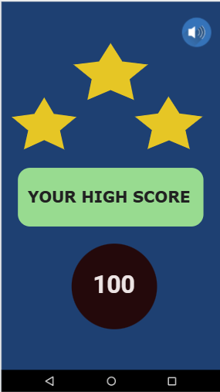

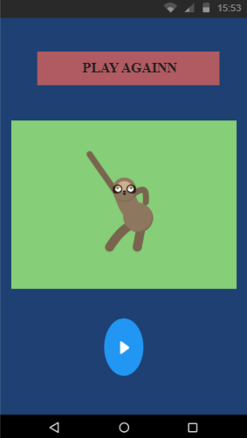
Results
AGB1211 – DESIGN THINKING

Slide 20
Conclusion
The proposed app for learn/play for children with disabilities aims to bridge the gap between traditional learning methods and the diverse needs of children with cognitive, physical, and sensory challenges. By integrating adaptive modules that prioritize inclusivity, accessibility, and engagement, the app can foster holistic development—enhancing cognitive, social, emotional, and physical skills.
Through its tailored learning paths, gamified experiences, and assistive technology integration, the app empowers children to explore, learn, and grow at their own pace. At the same time, it provides valuable support to caregivers and educators by offering insights, resources, and actionable feedback.
This initiative not only promotes inclusive education and play but also contributes to building a more equitable world where every child, regardless of ability, can thrive and reach their full potential. By prioritizing innovation, empathy, and accessibility, this app can serve as a model for future advancements in learn/play technologies for children with disabilities.
Would you like assistance refining this conclusion or tailoring it for a specific audience (e.g., funding proposals, educational institutions).
AGB1211 – DESIGN THINKING

Slide 21
Thank You
ANY QUERIES???
AGB1211 – DESIGN THINKING

